Slide 1

Temperature and Cardiovascular Related ER Visits in California: A Work in Progress
Annabel X. Tan, MPH
PhD Candidate
Dept of Epidemiology & Population Health
Stanford University

Slide 2

The Path to Environmental Justice
Environmental Justice is defined as the equal treatment and involvement of all people in environmental decision making
Principle 3
Environmental Justice mandates the right to ethical, balanced and responsible uses of land and renewable resources in the interest of a sustainable planet for humans and other living things
Principle 16
Environmental Justice calls for the education of present and future generations which emphasizes social and environmental issues, based on our experience and an appreciation of our diverse cultural perspectives
Notes:
Environmental Justice (EJ) is defined as the equal treatment and involvement of all people in environmental decision making.¹ Inspired by the Civil Rights movement, EJ became widespread in the 1980s at the intersection of environmentalism and social justice.² Environmental injustice is experienced through heightened exposure to pollution and corresponding health risks, limited access to adequate environmental services, and loss of land and resource rights.³ EJ and sustainability are interdependent and both necessary to create an equitable environment for all.⁴
Even though it may seem obvious – e.g. pollution is bad for you -- we need to provide evidence to show that many aspects of the environment have a negative association on health to advocate for the health of marginalized communities because these communities are simply not covered by regulations.
Simply put, poor communities and communities of color were exposed to more vulnerability than richer and whiter communities, and the reality and experience of such inequity spurred much environmental justice organizing. Environmental conditions were seen as yet another indicator, another symptom, of the larger reality of social and economic inequity many communities lived with every day. In this sense environmental justice is aimed at remedying existing and imminent injustice in the distribution of environmental costs, benefits, and conditions on the grounds that all are equal and have equal right

Slide 3
Warming climates affects the health and heart health of marginalized communities disproportionately
Racial or ethnic minority groups and low-income communities are more frequently exposed to environmental hazards such as air and water pollution and substandard housing.
People of color are at higher risk for hypertension, diabetes, and cardiovascular diseases (CVD) compared to white Americans.
A 1°C increase in temperature was positively associated with cardiovascular disease-related mortality across all considered diagnoses, especially among older adults. (Liu et al, 2022)

Slide 4
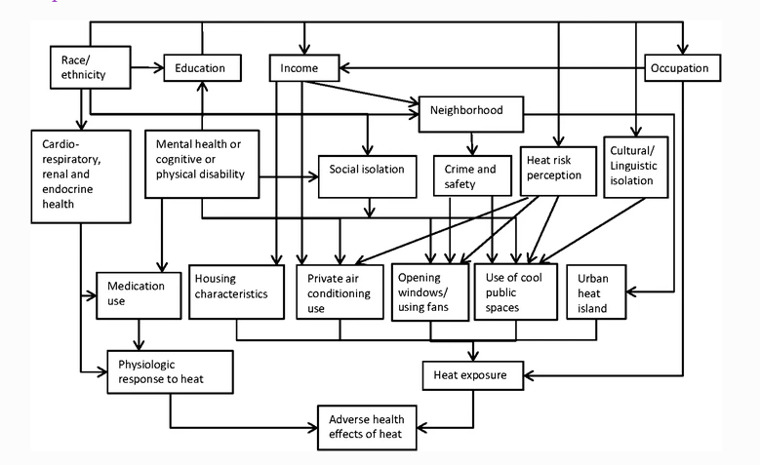
Extremes in temperature exacerbate disparities
Gronlund, C.J. Racial and Socioeconomic Disparities in Heat-Related Health Effects and Their Mechanisms: a Review. Curr Epidemiol Rep 1, 165–173 (2014). https://doi.org/10.1007/s40471-014-0014-4
Notes:
Extremes in temperature have been documented to exacerbate disparities.. Increased ambient temperatures can influence mortality risk either indirectly through risk factors such as blood pressure. In particular, we see in this diagram here by Gronlund et al how health effects of heat influence disparities. I’ll give you a minute to look over this slide, but essentially we see that temperature, because it’s environmental, affects lives in many ways we don’t often think of.
Other papers have shown that Black and African Americans are more likely to live in areas of highest projected increases in extreme temperature related deaths. Further, African American populations are also at higher risk for hypertension, diabetes, and cardiovascular diseases compared to white Americans, in part, due to this unequal and inequitable conditions in which people of color live.

Slide 5
Objectives & Hypotheses
To determine the effects of temperature on CVD related ER visits across all zip codes in California, and the extent to which income level and inequality modifies this association using data from the California Department of Health Care Access and Information (HCAI).
Higher ER visit rates will be associated with higher temperatures and greater changes in temperature (measured as % above the mean)
Zip codes with higher income inequality will experience higher ER visit rates due to increased temperature than zip codes with lower income inequality.

Slide 6
Methods: Data Management
Exposure
Covariates
Outcome
PRISM + Other authors
Census
California Department of Health Care Access and Information (HCAI)
Sources
Main ER visits of interest:
Cerebrovascular disease
Dysrhythmia
Heart failure
Ischemic heart disease
Peripheral arterial disease
Pulmonary embolism
Weather related:
Max temp
Min temp
Dew point (proxy for humidity)
PM2.5 (covariate)
Wildfire PM2.5 (covariate)
Gini coefficient
Rural/urban status
Population
2013-2020
Notes:
Put outcome on the right

Slide 7
Methods: Statistical Analyses
Case crossover analyses
Control period
Case period
Unidirectional
t-21
t-14
t-7
t0
Control period
Case period
Control period
Bidirectional
t-21
t-14
t-7
t0
t+7
t+14
t+21
Lag period
t-6
t-5
t-4
Conditional logistic regression
ER Visits (0/1) = temp + strata(matching variable)
t-3
t-2
t-1
Notes:
Several control periods
Including Before and After case period
0-6 lag days

Slide 8
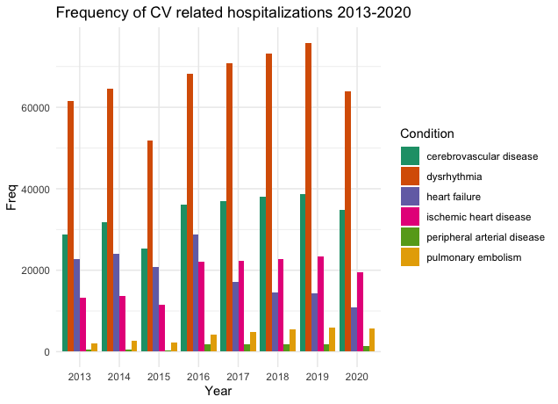
Distribution of Cardiovascular Conditions
Notes:
Use rates

Slide 9
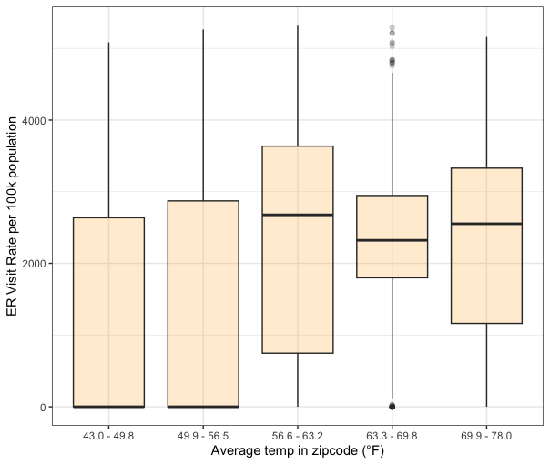
ER Visit Rate vs Average Temp (at a zip code level)
Notes:
Use rates

Slide 10
ER Visit Rates vs Gini coefficient

Slide 11
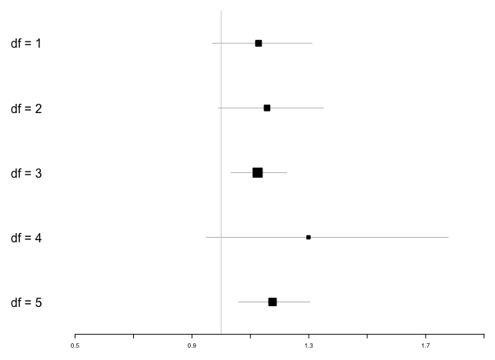
Are ER visits associated with temperature on day of visit?
Odds Ratio
ER visit ~ temperature on day of visit
1.13 (0.97 – 1.31)
1.16 (0.99 – 1.35)
1.13 (1.03 – 1.22) **
1.30 (0.95 – 1.77)
1.17 (1.06 – 1.30) **
Notes:
Visualize spline

Slide 12
Next steps
Run conditional logistic models, incorporating lag days using distributed non-linear lag (DLNM) for temperature
Compare performance between linear, splines, DLNM models
Compare differences in models in using symmetric/asymmetric control periods
Use change in temperature as an exposure across lag days

Slide 13

Acknowledgements
Stanford
Michelle Odden, PhD
Sam Heft-Neal, PhD
Andres Cardenas, PhD
Andy Chang, MD, MS
Harvard
Kari Nadeau, MD, PhD
Columbia
Robbie Parks, PhD
UCSD
Rosana Aguilera Becker, PhD

Slide 14


THANK YOU!
annabelxtan@stanford.edu
linkedin.com/in/annabelxtan

Slide 15
Table 1: Cohort Description
Stratified by condition
 | cerebrovascular disease | dysrhythmia | heart failure | ischemic heart disease | peripheral arterial disease | pulmonary embolism | p-value
n | 270703 | 530089 | 153048 | 148252 | 10139 | 32870
Age (%) |  |  |  |  |  |  | <0.001
<45 | 18279 (6.8) | 80241 (15.1) | 12707 (8.3) | 10366 (7.0) | 1709 (16.9) | 7312 (22.2)
45-54 | 29044 (10.7) | 62871 (11.9) | 19884 (13.0) | 21978 (14.8) | 1215 (12.0) | 5436 (16.5)
55-64 | 46783 (17.3) | 93199 (17.6) | 26129 (17.1) | 33876 (22.9) | 2070 (20.4) | 5941 (18.1)
65-74 | 64082 (23.7) | 121330 (22.9) | 28788 (18.8) | 36542 (24.6) | 2191 (21.6) | 6669 (20.3)
75-84 | 56527 (20.9) | 91808 (17.3) | 29512 (19.3) | 24318 (16.4) | 1468 (14.5) | 4428 (13.5)
85+ | 55988 (20.7) | 80640 (15.2) | 36028 (23.5) | 21172 (14.3) | 1486 (14.7) | 3084 (9.4)
Sex (%) |  |  |  |  |  |  | <0.001
Female | 136953 (50.6) | 253051 (47.7) | 64825 (42.4) | 56286 (38.0) | 5097 (50.3) | 17048 (51.9)
Male | 133737 (49.4) | 276888 (52.2) | 88218 (57.6) | 91954 (62.0) | 5041 (49.7) | 15821 (48.1)
Ethnicity (%) |  |  |  |  |  |  | <0.001
Hispanic/Latino | 58971 (21.8) | 96162 (18.1) | 32482 (21.2) | 33575 (22.7) | 2675 (26.4) | 5611 (17.1)
Non-Hispanic/Non-Latino | 207436 (76.6) | 422482 (79.7) | 118892 (77.7) | 112238 (75.7) | 7321 (72.2) | 26836 (81.7)
Race (%) |  |  |  |  |  |  | <0.001
White | 177553 (65.6) | 375644 (70.9) | 94112 (61.5) | 97408 (65.7) | 6927 (68.3) | 21983 (66.9)
Black/Afr Amer | 24377 (9.0) | 38080 (7.2) | 26312 (17.2) | 12954 (8.7) | 1113 (11.0) | 4700 (14.3)
Asian | 21985 (8.1) | 34878 (6.6) | 8111 (5.3) | 10899 (7.4) | 388 (3.8) | 1183 (3.6)
Am Indian/Alaska Native | 1354 (0.5) | 2470 (0.5) | 1100 (0.7) | 1144 (0.8) | 58 (0.6) | 188 (0.6)
Native Hawaiian/Pac Isl | 2188 (0.8) | 3965 (0.7) | 1519 (1.0) | 1297 (0.9) | 47 (0.5) | 169 (0.5)
Other | 38981 (14.4) | 64577 (12.2) | 20063 (13.1) | 21811 (14.7) | 1468 (14.5) | 4187 (12.7)
ginicoeff (mean (SD)) | 0.44 (0.04) | 0.44 (0.04) | 0.44 (0.04) | 0.44 (0.04) | 0.44 (0.04) | 0.44 (0.05) | <0.001
rural = 1 (%) | 11726 (4.5) | 20626 (4.1) | 6860 (4.7) | 9721 (6.8) | 526 (5.4) | 1496 (4.7) | <0.001

